Slide 1
Communications Kit for Districts AP 2020-21
®
August 2020

Slide 2
Communications for Your School Community
Emails, Newsletters, and Website Posts
View
This kit provides district and school leaders with ready-made communications and graphics that they can use to communicate with and support their school communities
You can copy and paste and personalize for your school.
This kit includes:
Voicemail and Text Content
View
Emails, Newsletters, Website Posts
Email: District Leaders to Principals
Email District Leaders to AP Teachers
General
AP Instructional Resources
Professional Learning
To New AP Teachers
Email: District Leaders to AP Coordinators
Reminders: District Newsletter or Website
Email: Principal to Staff
Email: Principal to Parents
Reminders: School Website or Newsletter
Voicemail and Text Reminders
Voicemail Reminder to Parents
Text messages to Students
Social Media and Website Assets
Social Media Posts for AP Teachers
Social Media Graphics for AP Teachers
Social Media Posts for Students
Social Media Graphics for Students
Website: Join Your AP Class Section Video
Social Media and Website Assets
View

Slide 3
Emails, Newsletters, and Website Posts for district leaders and principals to communicate with their school communities

Slide 4
Email: District Leaders to Principals
Dear Principal,
Please, take these action steps for your AP program, so your school can take advantage AP instructional resources, access professional learning opportunities, and order exams on time:
Review these AP updates
Share information with AP teachers and AP coordinators
Access administrator supports (bottom)
For Everyone:
All students should register for AP Exams this fall. This year, AP is waiving the $40 per exam cancellation fee.
May 2021 AP Exams will match the traditional, published exam descriptions, and AP will support in-school testing in 2021. A contingency testing option will be released in early 2021 if school buildings are closed in May due to safety concerns.
For AP Teachers:
AP teachers can use free, online instructional resources in AP Classroom to provide students with daily instruction, practice, and feedback on every course topic and skill that’s tested on an AP Exam.
Starting 9/1, AP teachers and students can access AP Daily, a series of new learning videos in AP Classroom.
For additional information on AP instructional resources download these one-pagers.
On-demand and live professional learning for AP teachers is available here.
For AP Coordinators:
AP coordinators can set up AP Registration and Ordering now, so students can register for exams and use AP Classroom.
For guidance, AP coordinators can view these step-by-step instructions.
On-demand and live PD for AP coordinators is available here.
For Administrators:
Ready-made communications: Use the attached kit created by AP to help you communicate with your staff and families. [attach/share portions of this kit with principals]
Principal webinar: View this 1-hour on-demand webinar for an overview of AP in 2020-21.
Principal newsletter: Check out the “Principal Monthly” newsletter email AP sends directly to principals.
As always, thank you for all you do.
[Signature/District Leader]
Recommended use:
For district leaders to send to principals
Copy and paste and personalize to fit your needs

Slide 5
Email: District Leaders to AP Teachers
Hi, AP Teachers,
As we move into the school year, we want to share important updates and supports that we hope are helpful for you as you plan, teach and support your students.
Important Action Items
Create your class sections in AP Classroom by working with your school’s AP coordinator.
Share your join codes with your students and help them enroll in your class sections by the 2nd day of school.
Start using AP Classroom resources to create assignments and monitor student progress (see “AP Instructional Resources for Any Learning Environment,” below).
Additional Information: For guidance on how to complete these steps, access these step-by-step instructions.
New AP teachers, be sure to submit your AP Course Audit form so you can access AP Classroom. View this new AP Teacher Checklist for guidance.
AP Instructional Resources for Any Learning Environment
Course and Exam Descriptions (CEDs) and Unit Guides: Your CED is the core document for your AP course, with course content and skills requirements and Unit Guides for most courses with pacing and sequencing recommendations.
AP Classroom: AP Classroom is an online platform with free, flexible online resources that can support your instruction everyday. New, short learning videos led by expert AP teachers will be available in AP Classroom starting September 1st! Called “AP Daily,” these videos are available for you to assign to students and for students to access directly.
Additional Information: For tips for teaching in any learning environment and guidance with helping students join AP Classroom, download these one-pagers.
Ongoing Support / Professional Learning
Supports and PD for AP teachers are online and more flexible than ever:
Webinars: Free on-demand and live webinars for new and experienced AP teachers
AP Classroom Quick Start Videos: Quick “how to” tutorials available in AP Classroom
AP Teacher Week 2020: YouTube videos, providing discipline-specific insights and best practices for AP Classroom
Course-specific AP workshops: Intensive, course-specific professional learning (Earn CEUs!)
The AP Teacher Community: Online community and network of AP teachers for your course
Visit AP Learning and Development page to find out more and access these supports
Please, let us know what questions you may have. Thank you for your ongoing flexibility and commitment to student learning.
[Signature/District Leader]
Recommended use:
For district leaders to communicate directly with AP teachers or to share with district or school instructional leads
Copy and paste and personalize to fit your needs

Slide 6
Email: District Leaders to AP Teachers AP Instructional Resources Segment
Hi, AP Teachers,
As an AP teacher, you have access to free instructional resources that work in any learning environment, providing you with daily support as you teach your students and help them learn and prepare them for AP Exams.
Here’s an overview of the free, instructional resources in AP Classroom, an online platform to support teacher instruction and student learning, every day:
Unit Guides help you sequence and pace course content and skills so your students have enough repetition of practice engaging with skills of increasing complexity.
AP Daily videos supplement direct instruction with short, targeted videos that support content and skills development for each topic within a unit.
Topic Questions provide students with practice applying the content and skills for each topic within a unit, enabling you to check for understanding early and often to inform individual and class-level supports.
Personal Progress Checks provide unit-wide formative assessment opportunities with multiple-choice and free-response questions that assess students’ progress of content and skills for each unit.
Progress Dashboard help you track student progress over time to develop targeted supports for students and make adjustments throughout the year as needed.
AP Question Bank is a searchable database of real AP questions, indexed by course content and skills, that provide AP teachers with customizable practice and tests that you can assign on paper or online
You can access AP Classroom now at myap.collegeboard.org
Need help getting started? Access step-by-step guidance to set up classes and enroll students or watch Quick Start videos and walk-throughs in AP Classroom’s Help Menu.
Need more info on how to use AP Classroom in a(n) [online, in-person, hybrid-blended] learning environment? Download these one-pagers.
Need more learning opportunities? Visit apcentral.collegeboard.org/learning-development
Thank you for all that you do.
[Signature/District Leader]
Recommended use:
For district leaders to communicate directly with AP teachers about AP’s Instructional Resources or to share with district or school instructional leads
Copy and paste and personalize to fit your needs

Slide 7
Email: District Leaders to AP Teachers Professional Learning Opportunities Segment
Hi, AP Teachers,
The AP Program is offering flexible, online support and professional learning to help you as you teach [online, in-person, hybrid/blended].
Here are some of the ongoing professional learning opportunities available to you. Access these and more at apcentral.collegeboard.org/learning-development.
Webinars and Online Sessions: Free, live, and on-demand webinars. In addition to others, these include:
Getting Started: For Teachers New to AP
AP Instructional Resources Overview
AP Teacher Week 2020: Videos on YouTube providing discipline-specific insights and best practices for using AP Classroom. These include 15-30 minute videos on the following:
AP Daily
Topic Questions
Progress Checks and Progress Dashboard
AP Question Bank
Course-specific AP workshops: Intensive, course-specific professional learning. These include:
AP Summer Institutes
AP Online One-Day Workshops
AP Classroom Quick Start Videos: Quick “how to” tutorials available in AP Classroom
The AP Teacher Community: Online community and network of AP teachers for your course where you can ask questions, discuss teaching strategies, and share resources.
Thank you for all that you do.
[Signature/District Leader]
Recommended use:
For district leaders to communicate directly with AP teachers about professional learning opportunities or to share with district or school instructional leads
Copy and paste and personalize to fit your needs

Slide 8
Email: District Leaders to AP Teachers New AP Teachers Segment
Hi, New AP Teacher,
Welcome to AP! As an AP teacher, you’re joining a large, supportive community of teachers from around the world and you’ll have access to free instructional resources that work in any learning environment.
To get started with your AP teaching journey, we recommend taking these key actions.
View and use this New AP Teacher checklist on AP Central or watch this free Getting Started webinar for teachers new to AP.
Complete your AP Course Audit form as soon as possible and complete the full AP Course Audit by January 31.
Help your students access AP Classroom as soon as possible to access AP Classroom resources and register for AP Exams.
Utilize AP Classroom resources for daily instructional support, no matter your learning environment.
Again, welcome and we appreciate all you do to support students.
[Signature/District Leader]
Recommended use:
For district leaders to communicate directly with teachers who are new to AP or to share with district or school instructional leads
Copy and paste and personalize to fit your needs

Slide 9
Email: District Leaders to AP Coordinators
Hi, AP Coordinators,
As we move into the school year, I want to share a few updates and reminders that I hope are helpful for you.
Immediate Next Steps for AP Exam Registration
Set up AP Registration and Ordering for 2020-21 by [enter district deadline here]
The AP Program emailed all AP coordinators their AP Registration and Ordering access code August 1. Don’t have it? Check with your principal, who also received the code, or call AP Services for Educators at 877-274-6474.
Create class sections by [enter district deadline here]
Please create these before the 1st day of class, so teachers can provide join codes to students to join their AP Classroom sections.
Visit this website for your AP coordinator page and more support with setup and class section creation.
Highlights for 2021 AP Exams
May 2021 AP Exams will match the traditional, published exam descriptions, and AP will support in-school testing in 2021. Schools will be able to divide testing across multiple dates, to reduce the number convening for any one exam. A contingency testing option will be released in early 2021 if school buildings are closed in May due to safety concerns.
All students should continue to register for their AP Exams in the fall. Given this year’s circumstances, the AP Program is waiving the $40 per exam cancellation fee or unused exam fee for any student who decides not to test.
Additional Supports
The AP Coordinator’s Manual, Part 1 for 2020-21 is the go-to resource for AP coordinators—download it here.
The AP coordinator newsletter provides updates via email directly from AP.
Flexible, online learning opportunities are also available:
Register for a 3-hour virtual workshop (these end September 10)
Attend a 4-part webinar series
Access self-guided tutorials for AP Registration and Ordering initial setup
Join the AP Coordinator Community
As always, thank you for all you do to support students and help our AP program run smoothly.
[Signature/District Leader]
Recommended use:
For district leaders who communicate directly with AP coordinators
Copy and paste and personalize to fit your needs

Slide 10
Reminders: District Website and/or Newsletter
Reminders for Parents/Guardians of AP Students
If your child is taking an AP course, they have more free support than ever to help them learn throughout the year and prepare for their May 2021 AP Exams, where students have the opportunity to earn college credit!
To help your child stay on track:
Make sure your child uses the join code your AP teacher gives them to join their class section. This will give them access to AP Classroom where they can practice their skills, receive feedback on their progress, and see real AP Exam questions.
Beginning September 1, AP Daily videos, on-demand lessons led by AP teachers from across the country, will be available in AP Classroom. Along with other free resources, they provide daily support for students. Students can watch them at their own pace on a mobile device or a computer with internet access, and teachers can also include them as part of their curriculum. There will be videos available for most courses.
Encourage your child to register for their AP Exams in the fall so they have the chance to stand out to college admissions officers and save money on tuition with a qualifying score of three or more.
Recommended use:
For district leaders to post to district website or include in district-sponsored newsletters to parents and students
Copy and paste and personalize to fit your needs
Consider pairing with the images on slides 24 - 26

Slide 11
Email: Principal to AP Teachers and AP Coordinator
Dear AP teachers and AP coordinator,
As we start the year, I want to share supports the AP Program is providing to our school—supports that work for online, in-person, and hybrid/blended instruction.
Everyone:
All students should continue to register for their AP Exams in the fall. Given this year’s circumstances, the AP Program is waiving the $40 per exam cancellation fee or unused exam fee for any student who decides not to test.
May 2021 AP Exams will match the traditional, published exam descriptions, and AP will support in-school testing in 2021. If we are still social distancing, will be able to divide testing across multiple dates, to reduce the number convening for any one exam. A contingency testing option will be released in early 2021 if school buildings are closed in May due to safety concerns.
AP Teachers:
You can use free, online instructional resources in AP Classroom to provide students with daily instruction, practice, and feedback on every course topic and skill that’s tested on an AP Exam.
Starting September 1, AP teachers and students can access AP Daily, new learning videos in AP Classroom.
For additional information on AP instructional resources, download these one-pagers.
On-demand and live professional learning for AP teachers is available here.
For AP Coordinators:
You can set up AP Registration and Ordering now, so students can register for exams and utilize AP Classroom.
For guidance, AP coordinators can view these step-by-step instructions.
On-demand and live PD for AP coordinators is available here.
I continue to be inspired by your hard work and your commitment to our students.
Thank you for all you do,
[Signature/Principal]
Recommended use:
For district leaders to share with principals, so principals can utilize for staff communication
Copy and paste and personalize to fit your needs

Slide 12
Email: Principal to Parents of Prospective / Current AP Students
Dear Parent / Guardian,
We want to thank you for all you do as you remain committed to your child’s growth and development. As we continue to face uncertainties, our commitment to your child’s learning is stronger than ever.
During this time, we want to remind you that your child still has the opportunity to tackle college-level work by taking AP. AP students can count on the online tools provided by AP to support [online, hybrid/blended, in-person] learning:
If your child already signed up for AP, they have more support than ever before to help them learn throughout the year and prepare for AP Exams.
Make sure your child uses the join code their AP teacher gives them to join their class section. This will give your child access to AP Classroom, where they can practice applying the knowledge and skills they learn in their AP courses.
Beginning September 1, AP Daily videos, on-demand lessons led by AP teachers from across the country, will be available in AP Classroom. Along with other free resources, they provide daily support for students. Students can watch them at their own pace on a mobile device or a computer with internet access, and teachers can also include them as part of their curriculum. There will be videos available for most courses.
Looking ahead to May 2021, AP Exams will cover the full course scope and content because colleges expect it. And if our school building is closed in May 2021 due to safety concerns, the AP Program will provide a contingency option for AP Exam testing. We expect to know more about this in early 2021. In either circumstance, we encourage AP students to register for their AP Exams in the fall so that they have the chance to stand out to college admissions officers and save money on tuition with a qualifying score of three or more.
As always—and especially during this year—we’re very grateful for your support.
Thank you,
[Signature/Principal]
Recommended use:
For district leaders to share with principals, so principals can utilize for parent communication
Copy and paste and personalize to fit your needs

Slide 13
Reminders: School Website and/or Newsletter to AP Parents
Reminders for Parents/Guardians of AP Students
If your child already signed up for AP coursework, they have more support than ever to help them learn throughout the year and prepare for AP Exams, where students have the opportunity to earn college credit!
Our team of AP teachers remain dedicated to providing your child with a powerful learning experience this year, and because we know the importance of parent involvement, we have a few updates to help your child stay on track:
Make sure your child uses the join code their AP teacher gives them to join their class section. This will give them access to AP Classroom where they can practice their skills, receive feedback on their progress, and see real AP Exam questions.
Remind your child to watch AP learning videos. Starting on September 1, short, on-demand learning videos called “AP Daily” will be available in AP Classroom. AP students can watch these at their own pace on a mobile device or a computer with internet access, or teachers can assign them as part of their curriculum. These are available for most courses.
Encourage your child to register for their AP Exams in the fall so that they have the chance to stand out to college admissions officers and save money on tuition with a qualifying score of three of more.
Know that May 2021 AP Exams will cover the full course scope and content because colleges expect it. And if our school buildings are closed in May 2021 due to safety concerns, the AP Program will provide a contingency option for AP Exam testing. We expect to know more about this in early 2021.
Recommended use:
For district leaders to share with principals, so principals can post to their school website or place in their school newsletter to parents
Copy and paste and personalize to fit your needs

Slide 14
Voicemail and Text Content
for districts and schools to communicate with parents and students

Slide 15
Voicemail to Parents
1
Congratulations! Your child is starting their year strong with AP. Make sure they use the join code their AP teacher provides them so that they have access to all the online resources in AP Classroom. Make sure they visit myap.collegeboard.org to take the next step.
2
Have your children been taking advantage of AP Daily in AP Classroom? These short, mobile-friendly AP videos help them stay on track throughout their AP course. Make sure they visit myap.collegeboard.org to tune in.
3
4
Reminder: the deadline for AP students to use their AP Classroom join codes and join their teacher’s online class sections is [date]. The deadline for students to tell us they’re registering for their 2021 AP Exam is [date].
Taking an AP course helps your child stand out to colleges and can earn you college credit. Be sure your child tells their AP coordinator they plan to take their exam in May 2021.
Recommended use:
For district or school leaders to use to leave voicemails directly with parents (or any other similar communication channels)
Personalize to fit your needs

Slide 16
Text Messages Reminders to Students
1
You've got what it takes to succeed in your AP course this year! Use the join code your AP teacher gave you to join your online class section in AP Classroom. myap.collegeboard.org
2
Don’t forget! You can watch new, short, mobile-friendly AP Daily videos in AP Classroom to stay on track with your course this school year. myap.collegeboard.org
3
Did you know there are online resources to help you with your AP course? Sign in to AP Classroom now. myap.collegeboard.org
4
Taking an AP course helps you stand out to colleges. Tell your AP coordinator you plan to take your exam next year.
5
Reminder: the deadline to tell your AP coordinator, [AP coordinator name], you're registering for your 2021 AP Exam is [date].
Recommended use:
For district or school leaders, AP coordinators, or AP teachers to use to communicate directly with students, as appropriate, through text (or any other similar communication channels)
Copy and paste and personalize to fit your needs

Slide 17
Social Media and Website Assets for districts and schools to communicate with AP teachers, students, and parents

Slide 18
Social Media Posts to Reach AP Teachers
New AP teachers: Welcome to the AP community! Visit the AP Central Learning & Development page to get started. apcentral.collegeboard.org/learning-development
1
2
AP teachers: AP resources provide supports and instructional tools for you to use in any learning environment. Sign in to AP Classroom to access your resources: myap.collegeboard.org
3
AP teachers: New, flexible, online professional learning is available now! Check it out at apcentral.collegeboard.org/learning-development
4
AP teachers: Starting September 1, new, short learning videos can help your students in any learning environment. Check out these “AP Daily” videos at myap.collegeboard.org
5
AP teachers: Let’s help students get into AP Classroom ASAP, so you can start using AP resources and help students register for exams. See these guides for support.
Recommended use:
For districts or principals to post to social media pages (e.g., Twitter, Instagram) to communicate with AP teachers and other interested stakeholders
Post a message alone or include a corresponding graphic from slides 19 - 22
Copy and paste and personalize to fit your needs
6
AP teachers: Help your students commit to completing their AP journey this year! Work with your school’s AP coordinator to ensure your students have committed to registering for their 2021 AP Exams before the November 13 deadline.

Slide 19
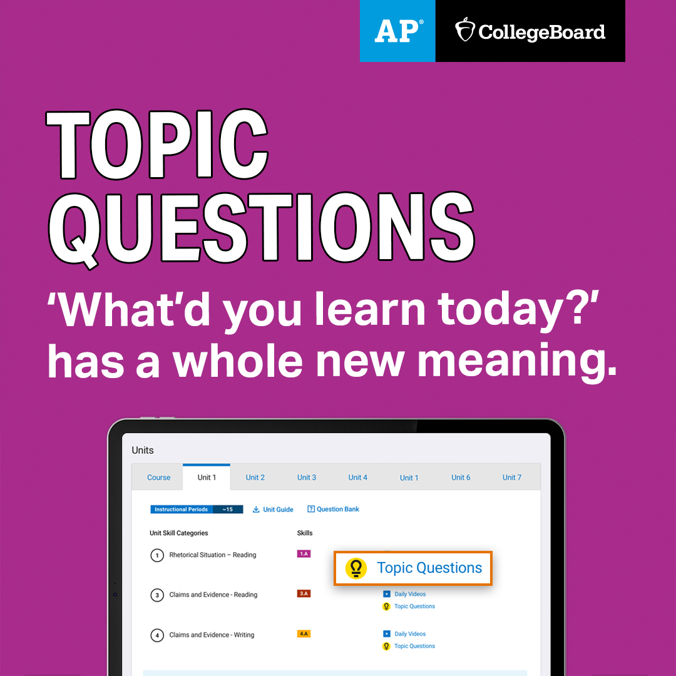
Social Media & Website Graphics to Reach AP Teachers
1080x1080 graphics
Recommended use:
For districts or school staff to post to their website or social media pages to communicate with AP teachers
Post a graphic along with a link to AP Classroom or pair with a corresponding message on slide 18
You can right-click an image on this slide to copy or save it, or you can download all of the graphics here.

Slide 20
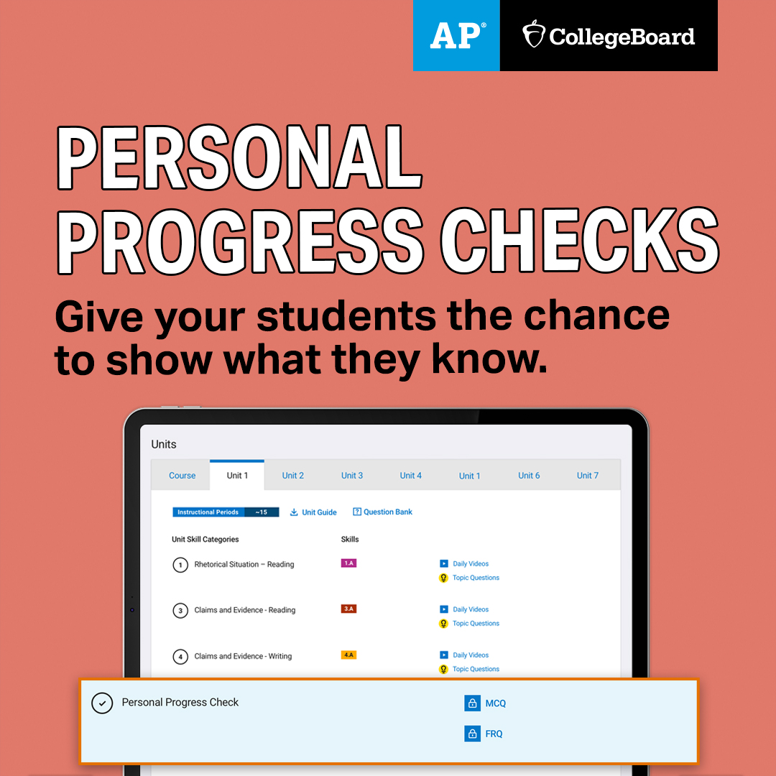
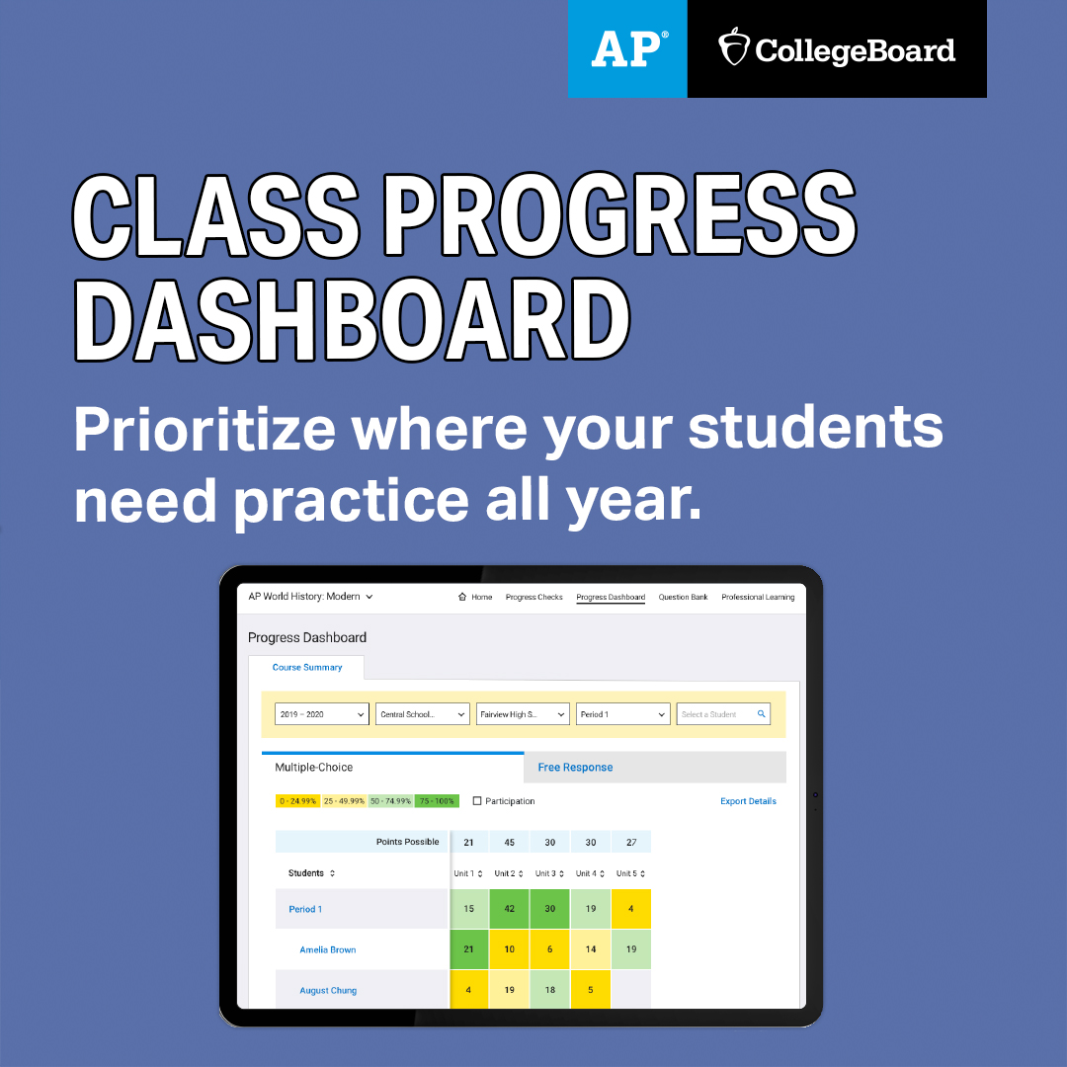
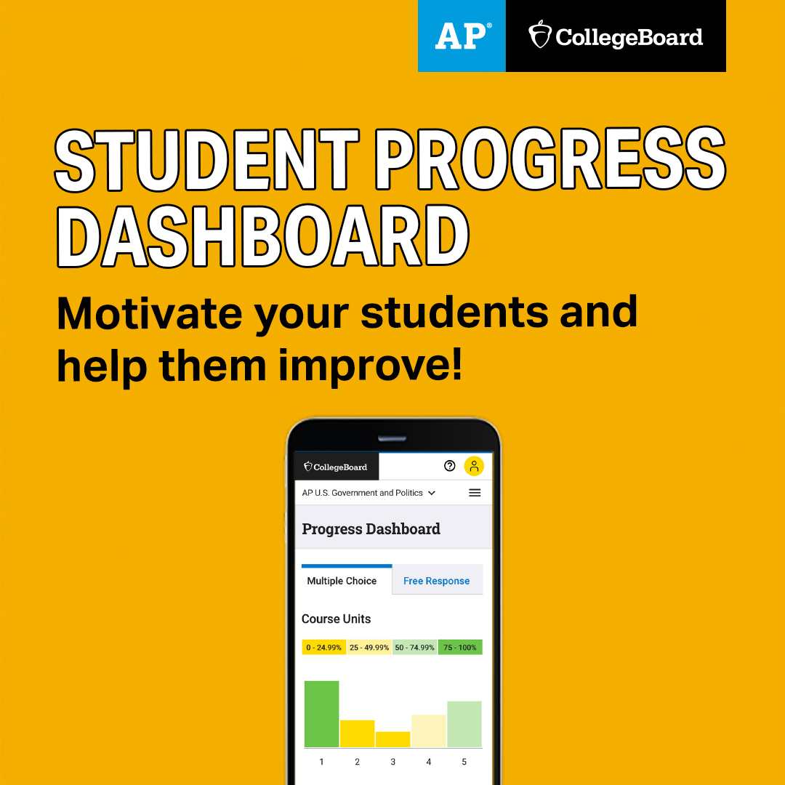
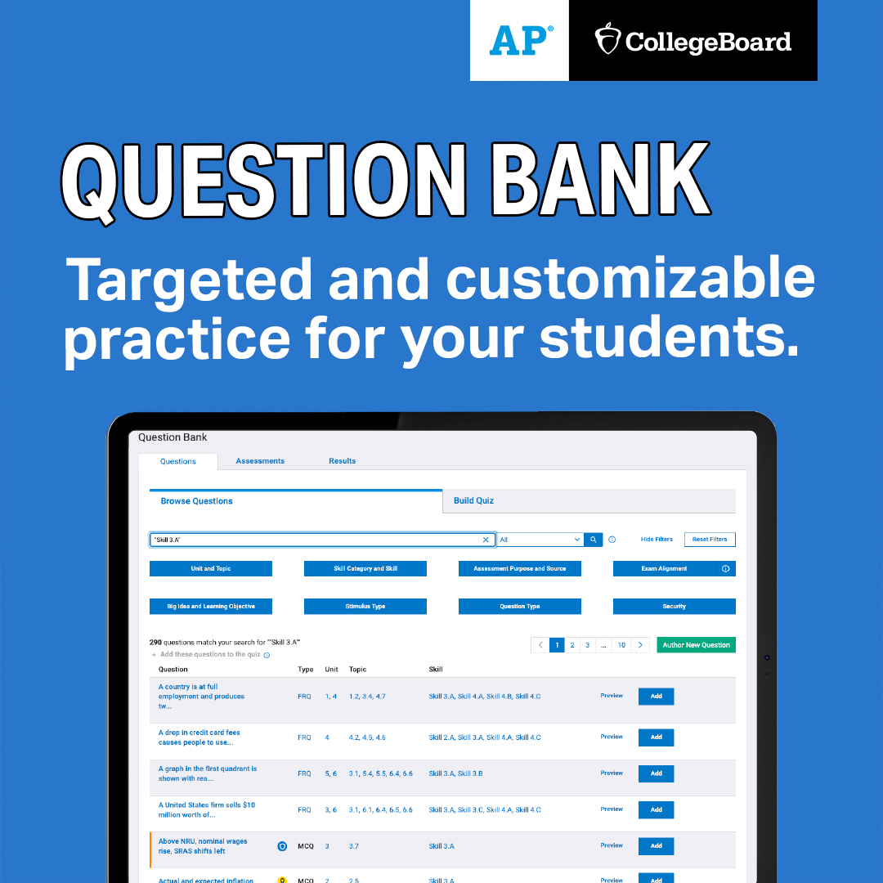
Social Media & Website Graphics to Reach AP Teachers
1080x1080 graphics
Recommended use:
For districts or school staff to post to their website or social media pages to communicate with AP teachers
Post a graphic along with a link to AP Classroom or pair with a corresponding message on slide 18
You can right-click an image on this slide to copy or save it, or you can download all of the graphics here

Slide 21
Social Media & Website Graphics to Reach AP Teachers
728x90 banners
Recommended use:
For districts or school staff to post to their website or social media pages to communicate with AP teachers
Post a graphic along with a link to AP Classroom or pair with a corresponding message on slide 18
You can right-click an image on this slide to copy or save it, or you can download all of the graphics here

Slide 22
Social Media & Website Graphics to Reach AP Teachers
728x90 banners
Recommended use:
For districts or school staff to post to their website or social media pages to communicate with AP teachers
Post a graphic along with a link to AP Classroom or pair with a corresponding message on slide 18
You can right-click an image on this slide to copy or save it, or you can download all of the graphics here.

Slide 23
Social Media Posts to Reach AP Students
1
Congratulations to all students taking AP this year! You’ve got what it takes to succeed.
2
AP students, with AP Classroom and AP Daily, you have the tools to help you succeed in your AP course this year. Sign in now: myap.collegeboard.org
3
AP students, remember to use the join code your AP teacher gave you to join your class section online in AP Classroom at myap.collegeboard.org
4
Starting September 1, new, short, mobile-friendly learning videos can help you with AP this year. AP students should check out these “AP Daily” videos now at myap.collegeboard.org
5
Reminder for AP students: The deadline to tell your AP coordinator you're registering for your 2021 AP Exam is [date].
6
Students, by taking an AP course and exam, you can earn college credit, skip introductory courses, and stand out in the admissions process. apstudents.collegeboard.org
Recommended use:
For districts or principals to post to social media pages (e.g., Twitter, Instagram) to communicate with AP students
Post a message alone or include a corresponding graphic from slides 24 - 26
Copy and paste and personalize to fit your needs
All AP students should commit to AP Exams this fall. And students can register with confidence—given this year’s circumstances, AP will waive the $40 canceled exam fee if you later decide not to test.
7

Slide 24
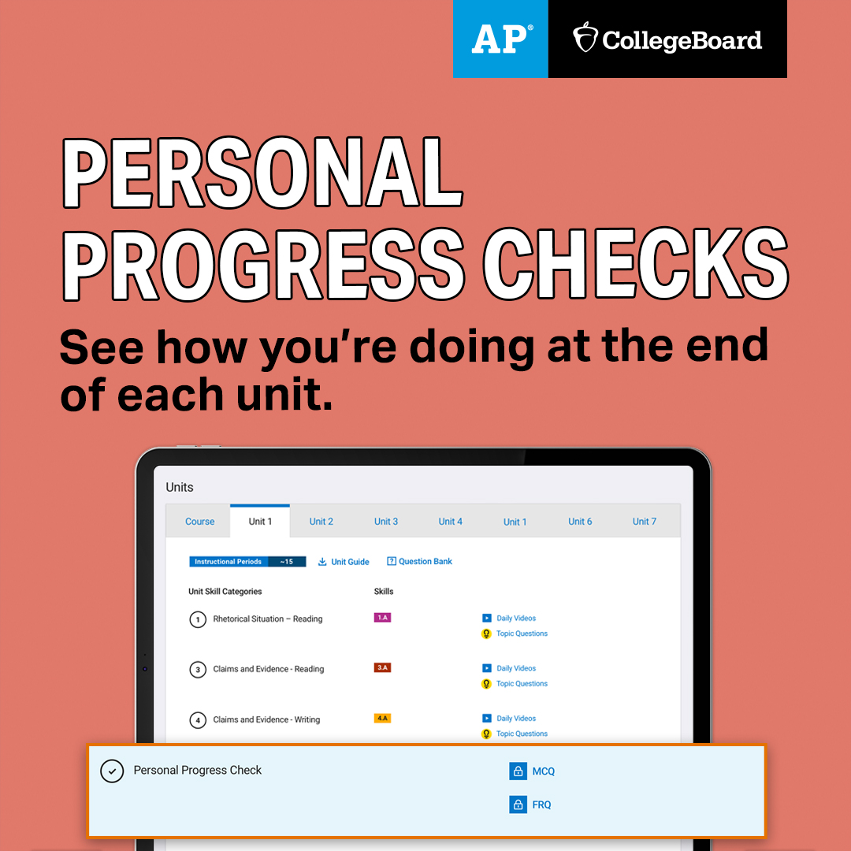
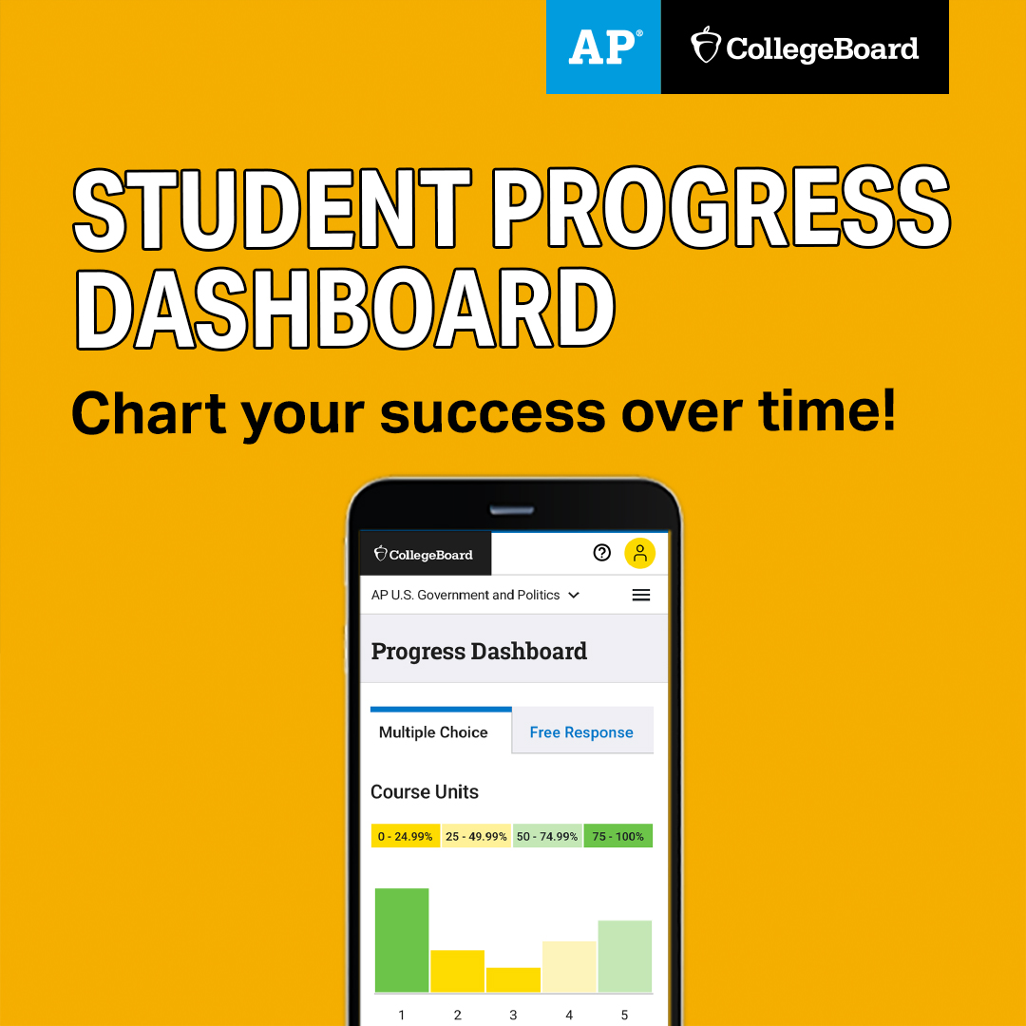
Social Media & Website Graphics to Reach AP Students
1080x1080 graphics
Recommended use:
For districts or school staff to post to their website or social media pages to communicate with prospective and current AP students
Post a graphic along with a relevant link or pair with a corresponding message on slide 23
You can right-click an image on this slide to copy or save it, or you can download all of the graphics here

Slide 25
Website: Join Your AP Class Section Video
Recommended use:
For districts or school staff to post to their website: https://www.youtube.com/watch?v=ISIkjZ7AryE&feature=youtu.be
This video shows students how to join their AP Class Section. Click the image to access the YouTube video.

