Slide 1
National Geological and Geophysical Data Preservation Program (NGGDPP): FY 2022 Program Announcement
Michaela (Mikki) Johnson, Associate Program Coordinator NGGDPP
Lindsay Powers, Program Coordinator NGGDPP
Warren Day, Earth MRI Science Coordinator
October 25, 2021

Slide 2
Overview
Program Background
Program Announcement
Priorities
Ancillary Grant Requirements
Tips for Successful Proposals
Contacts

Slide 3
National Geological and Geophysical Data Preservation Program (NGGDPP)
NGGDPP strives to advance the preservation of physical samples and earth science assets for future use, to inform new scientific discovery, hazard mitigation, and infrastructure, natural resource and green energy development.
Energy Policy Act - NGGDPP Act of 2005 directs the Secretary of the Interior to:
archive geologic, geophysical, and engineering data, maps, well logs, and samples;
provide a national catalog of such archival material; and
provide technical and financial assistance related to the archival material.
State geological surveys and DOI Bureaus
Minimum 1:1 match to federal $$ - State match can include private contributions (property and services)
Reauthorized through 2029 @ $5M per year, currently funded at $1.3M
Michaela Johnson – mrjohns@usgs.gov

Slide 4
NGGDPP’s vision is a world where all public domain physical samples and geological resources are readily discoverable, accessible and re-usable.

Slide 5
Participation eligibility
State geological surveys
Universities - if the state geological survey is organized under a state university system
States may include partner (private, government, academia) contribution of property and services to their cost share

Slide 6
How to apply?
Visit grants.gov, search for Grant Opportunities: G22AS00033 (or, term “data preservation”)
Download application and forms
Register in grants.gov – start early (new registration is lengthy)
Instructions are provided in Program Announcement

Slide 7
2022 Priorities
Priority 1 (P1): Preserve geoscience data and materials
Priority 2 (P2): Preserve and compile critical minerals resources and develop long-range critical minerals data preservation plan
2022 AASG/USGS Data Rescue and Preservation Workshop
2022 Earth MRI Critical Minerals Workshop

Slide 8
Program Announcement Requirements
100% or greater match with state to federal funds per Priority
Limit of no more than 4-pages per Priority description
CVs for project personnel
Data management plan (DMP)
Digitized and scanned map products submitted to NGMDB
Geologic maps in GeMS standard
Final technical report and deliverables with metadata to the National Digital Catalog (NDC)
Cannot use NGGDPP funds to preserve USGS assets
Submission deadline: December 17, 2021

Slide 9
2022 and Recent Program Announcement Changes
Geologic Mapping in Priority 1 only– non-GIS maps to GeMS
(remember, no support for USGS maps)
Support for physical infrastructure development
Preservation of subsurface data and samples in both Priority 1 & 2
Workplans include QA/QC
Long term data preservation strategy for critical minerals (Priority 2)
Data deliverables templates (Min Deposits/Districts and Borehole)
Data Management Plan in NGGDPP format
2022 Workshops - Travel funding cancelled if workshops will be virtual

Slide 10
Priority 1: Preserve Geoscience Data and Materials
NGGDPP awards grants to States to support data and sample preservation to provide foundational geoscience information in FY 2022 for hazard mitigation,, climate studies, subsurface resources, physical infrastructure development, and/or clean/green energy. NGGDPP coordinates with NCGMP to support GeMS activities.
Inventory, preserve, rescue, archive and/or modernize geologic, geophysical, and engineering materials for public access:
data, samples, maps, notebooks, publications, well logs, photographs, databases, web applications, data formats, data storage media, physical storage

Slide 11
Priority 1: Preservation Project Examples
Digitize analog data, paper media, photographic media, physical samples etc.
Preserve paper or scanned geologic maps to GeMS standard database.
Improve infrastructure to house, protect and organize samples and artifacts.
Preserve subsurface data and sample resources including drill core/borehole information
Rescue valuable materials in imminent danger of loss.
Enhance or develop data archiving systems, databases, and web applications to preserve and expose collections and data.

Slide 12
Priority 1: Data Templates
Borehole information (excel) – Attachment E_NGGDPP borehole template.xlsx
Compiled data in consistent format across states supports ease of use
Point locations with available ancillary data.
Preparation for inclusion in the National Index of Borehole Information (NIBI)
Preparation of subsurface resources to support the U.S. GeoFramework Initiative (USGI)
Data Preservation: Grant Templates

Slide 13
NDC as a file repository
Data and document files (PDFs, tables, TIFFs) may be stored and made available for download in NDC.
NDC must serve as primary access and distribution point for the stored digital files (files may not be publicly available elsewhere online).
NDC should not be used to archive larger file formats (TIFF) if smaller file formats (PDF) are available online.
Files may not be copyrighted or publicly restricted.

Slide 14
2022 AASG/USGS Data Preservation Workshop
Fall 2022 hosted by Montana Bureau of Mines and Geology in Butte, MT
Federal funds may sponsor $1500 per participant, 2 participants max (additional personnel may attend using state funds)
Workshop is open to representatives of state geological surveys, museums, USGS and other federal agencies

Slide 15
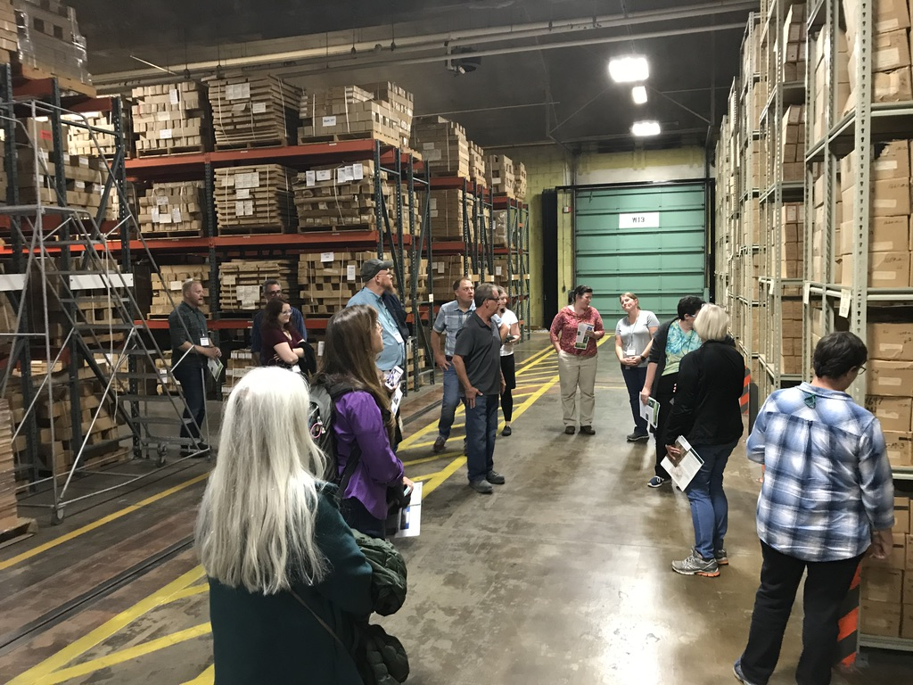
2022 AASG/USGS Data Preservation Workshop
Objectives: share information, provide training opportunities, present successful preservation efforts, promote networking and recommended practices
States that apply for workshop travel matching funds will receive these funds even if a preservation project is not proposed or the proposed project is not funded. All federal travel funds must be matched.

Slide 16
Priority 2: Critical Mineral Resources
NGGDPP collaborates with the Earth Mapping Resources Initiative (Earth MRI) to support data preservation activities focused on critical mineral resources.
Priority 2 – up to $35K with 1:1 state match
FY2022 Priority 2 Topics
State compilation of mineral deposits/districts
Contribute state data to USGS map compilation of Earth MRI focus areas
State compilation of borehole data with metadata to the National Digital Catalog
Prepare for and attend Earth MRI Critical Minerals Workshop
Long term strategic plan for critical minerals ($3K – noncompetitive)

Slide 17
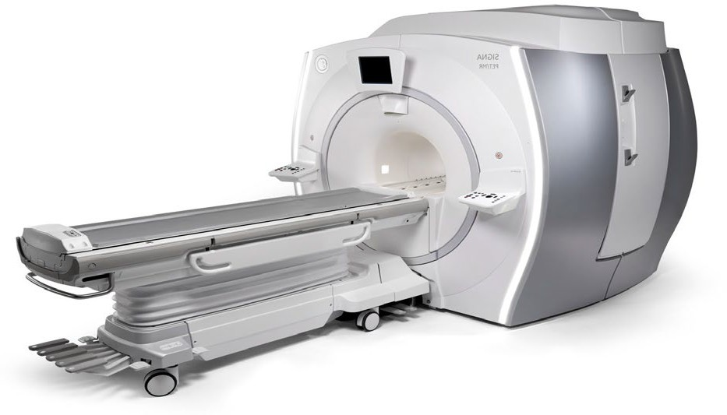
Critical minerals support the global economy
Growing demands of current and future technologies require increased supply
Energy generation
60
Nd
Neodymium
Healthcare
64
Gd
Gadolinium
58
Ce
Cerium
49
In
Indium
Thin-film solar PV
66
Dy
Dysprosium
63
Eu
Europiu
65
Tb
Terbium
31
Ga
Gallium
71 ^{m}
Lu
39
Y
Yttrium
34
Se
Seleniu m
Offshore direct drive wind turbine
Lutetium
Photo credit: Testbourne, Ltd.
PET/CT diagnostic imaging
Photo credit: US DOE
Defense and
32
Ge
Germaniu
Photo credit: GE Healthcare
Transportation
75
Re
Rhenium
national security
3
6
C
Carbon
m
Li
31
Ga
Gallium
Lithium
27 28
Co Ni
Cobalt Nickel
U.S. Air Force F-35A Lightning II Joint Strike
Fighter
Photo credit: Master Sgt. John R. Nimmo, Sr.
33
As
Arsenic
Gen. III Ground
Photo credit: Telsa, Inc.
Panoramic Night Vision
Photo cred_{G}it: _{o}L3_{g}T_{g}e_{l}c_{e}hn_{s}ologies, Inc.
Electric and hybrid vehicles

Slide 18
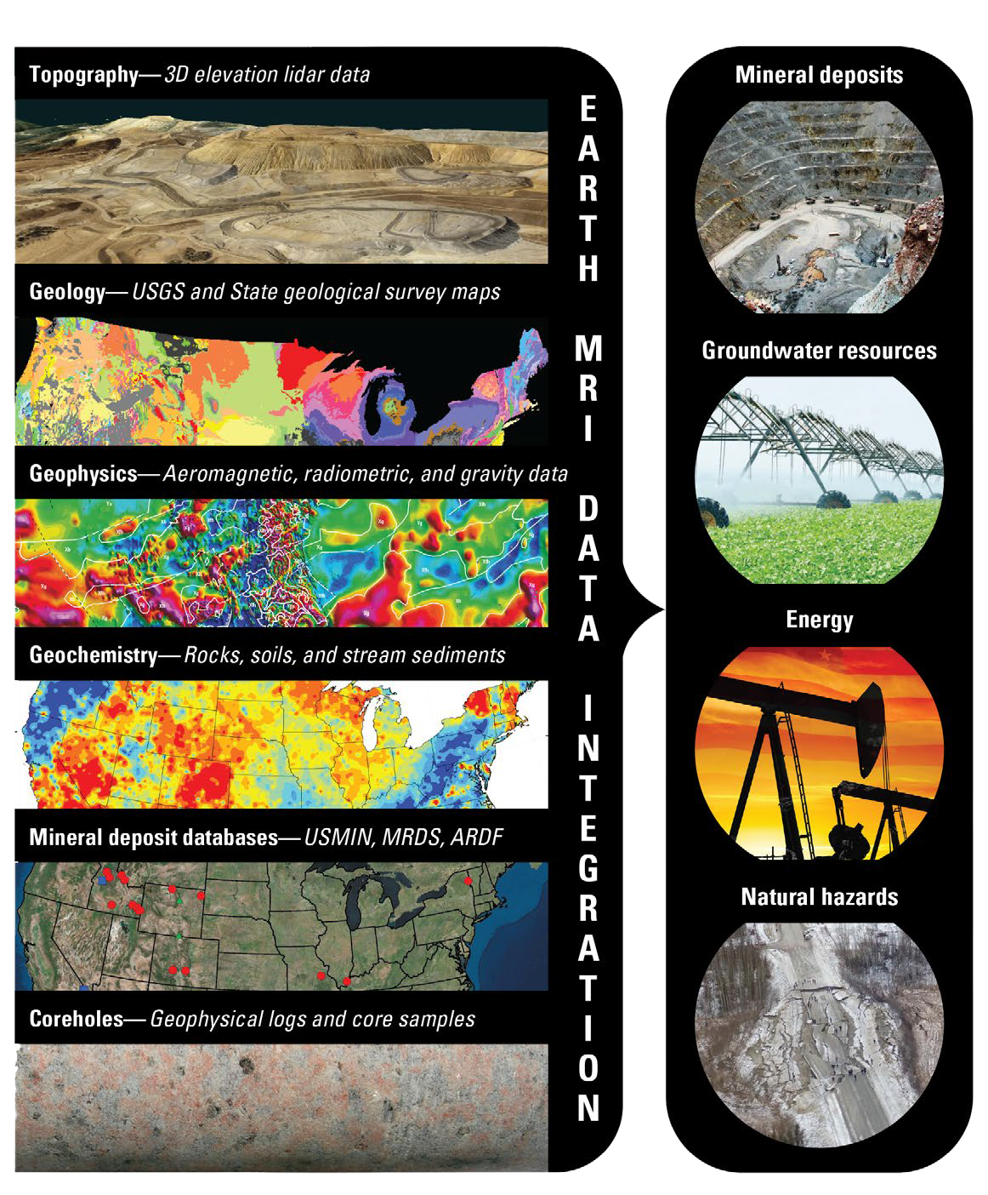
USGS Earth Mapping Resources Initiative (Earth MRI)
Partnership between the USGS, State Geological Surveys, and the private sector to generate state-of-the-art geologic maps, airborne magnetic and radiometric surveys, and surface elevation (lidar) data in areas permissive for hosting critical minerals
Goal: Improve the knowledge of the geologic framework of the United States and to identify areas that have the potential to contain undiscovered critical mineral resources
Data have additional broad applications to energy, groundwater, natural hazards, and other geoscience issues
Earth MRI is stimulating a renaissance in economic geology research community
FY2022 funding levels pending. Base at $10.6M

Slide 19
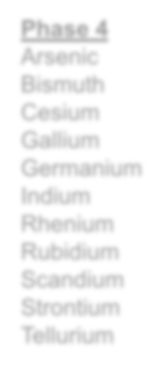
Project Phase by Critical Mineral Commodity
U.S. list of 35 critical minerals (2018)
Earth MRI needs national-scale maps showing where critical minerals may occur to drive science-based funding decisions.
You are here
Phase 1
Rare earth element group
Phase 2
Aluminum Cobalt
Graphite (natural)
Lithium Niobium Platinum group elements
Rare earth element
group Tantalum Tin Titanium Tungsten
Phase 3 Antimony Barite Beryllium Chromium Fluorspar Hafnium Helium Magnesium Manganese Potash Uranium Vanadium Zirconium
Phase 4 Arsenic Bismuth Cesium Gallium Germanium Indium Rhenium Rubidium Scandium Strontium Tellurium
Phase 1: Rare earth elements.
Phase 2: Primary and co-product critical mineral commodities for which new geologic information will impact discovery and production.
Phase 3: Co-products and by-product commodities for which new geologic information will impact discovery and production.
Remaining mineral commodities are primarily by-products from mining of other commodities. Their recovery is largely dependent on the economics of recovery and market forces.
Adding: zinc and nickel

Slide 20
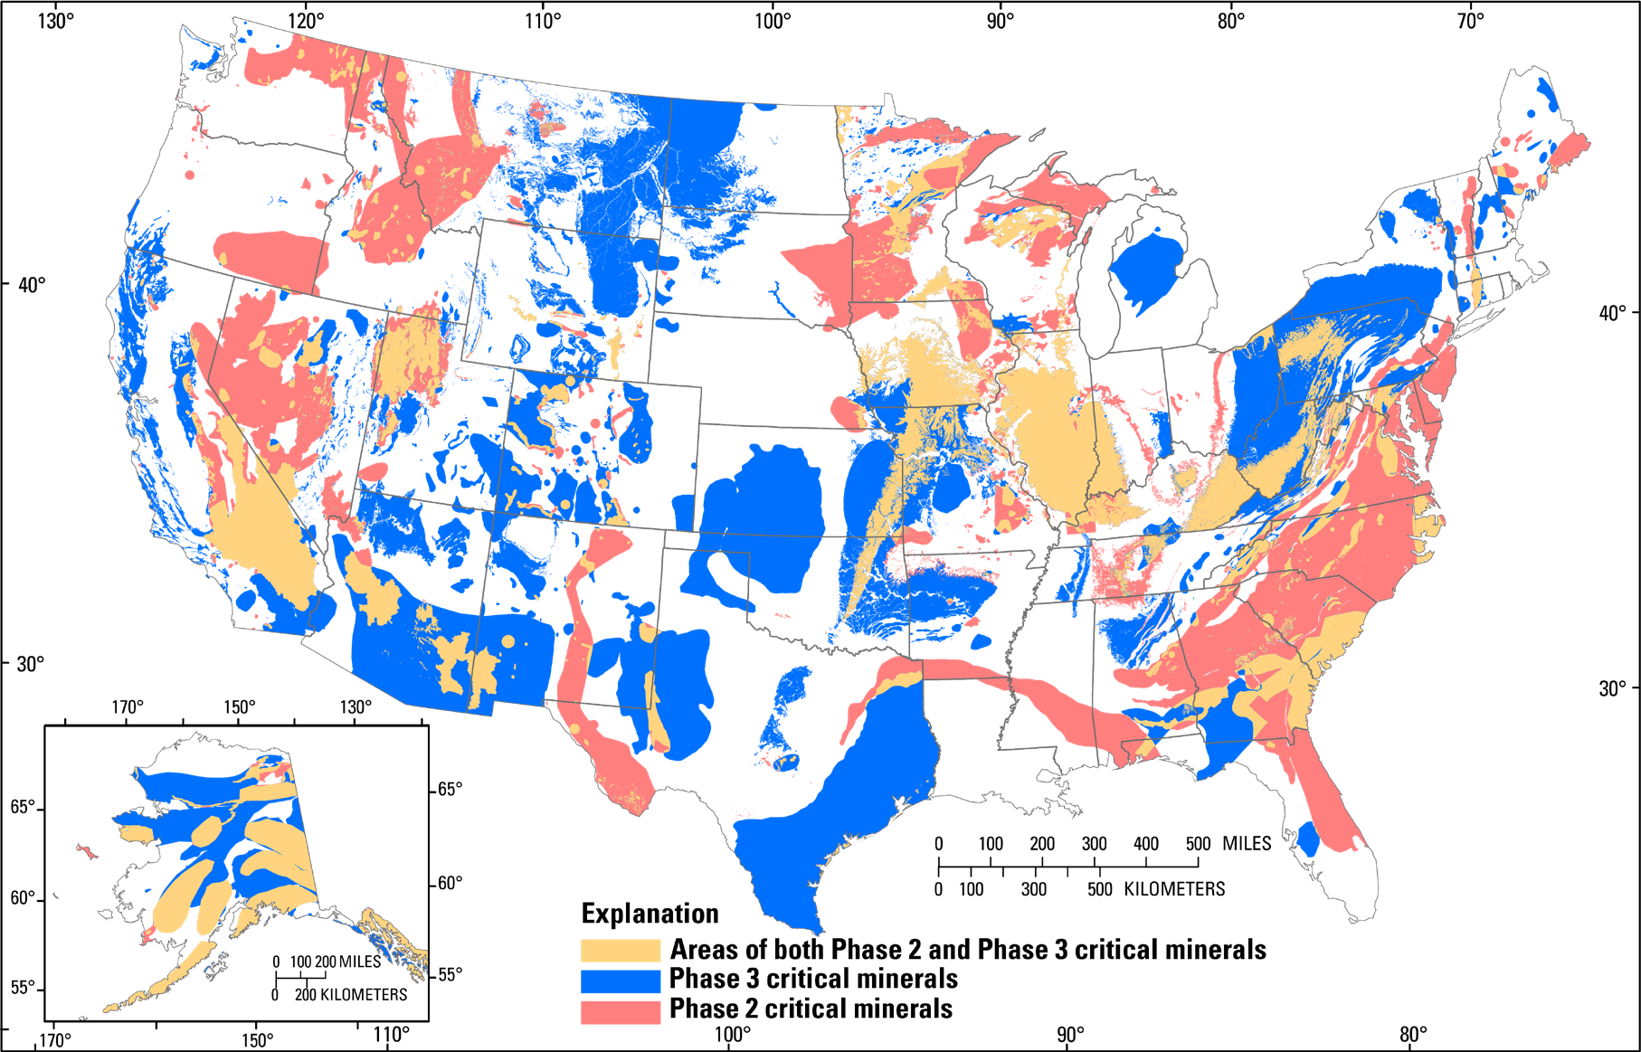
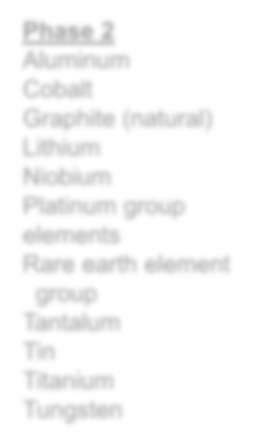
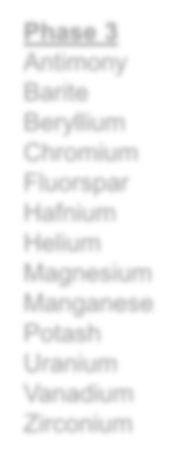
Permissive Areas for Mineral Systems with Critical Minerals
Earth MRI Project Phase Critical Minerals
Phase 2 Aluminum Cobalt
Graphite (natural) Lithium
Niobium Platinum group elements
Rare earth element group
Tantalum Tin Titanium Tungsten
Phase 3 Antimony Barite Beryllium Chromium Fluorspar Hafnium Helium Magnesium Manganese Potash Uranium Vanadium Zirconium
Sources:
Dicken and others, 2021, USGS data release, https://doi.org/10.5066/P9WA7JZY
Dicken and Hammarstrom, 2020, USGS data release, https://doi.org/10.5066/P95CO8LR

Slide 21
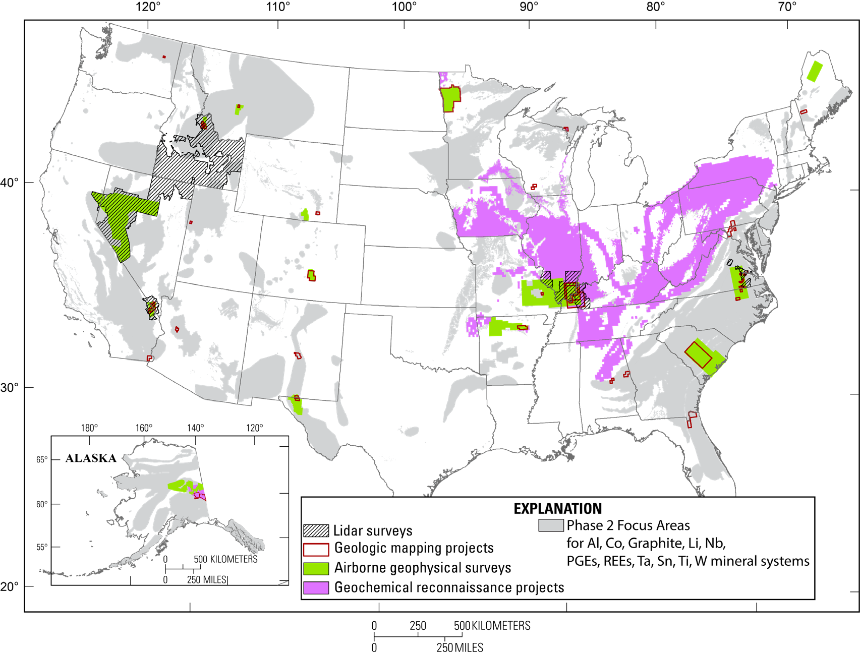
Earth MRI FY2019-FY2021 Projects
FY19 Activities:
14 geologic mapping projects
5 airborne geophysical surveys
5 lidar surveys
FY20 Activities:
12 geologic mapping projects
4 geochemistry projects
6 airborne geophysical surveys
1 GeoDAWN lidar survey
FY21 Activities
14 geologic mapping projects
2 geochemistry projects
5 airborne geophysical surveys
1-2 large lidar surveys
Data available at https://www.usgs.gov/earthmri

Slide 22
Priority 2: Earth MRI background: The “So What”
State compilation of mineral deposits/districts
Optimally would result in State publications and/or internet map services
Online example: Arizona @ http://minedata.azgs.arizona.edu/
Contribute state data to USGS map compilation of focus areas
Output from workshops resulting in focus area GIS and minerals information.
Information rolled up into USGS publications
Ex: Phase 3 focus area data release Dicken and others (2021)
Can find all data and publications on https://usgs.gov/special-topics/earthmri
State compilation of borehole data with metadata to the National Digital Catalog
Goal: make state borehole information available to the public for mineral exploration boreholes
Enable users to conduct 3-D modeling and mapping

Slide 23
Priority 2: FY22 Supported Activities for Data Discovery and Compilation
Participate in Earth MRI workshops to help define deposit types and focus areas likely to contain critical mineral resources
Expectation: State representative technical experts attend workshops to identify mineral deposits/belts and help delineate potential new projects and share State results. What have we learned and how can we improve?
Contribute state data on 35 (+2 – zinc and nickel) critical minerals to USGS map compilation of focus areas
Document ongoing exploration activities focused on critical minerals

Slide 24
Priority 2: FY22 Supported Activities for Data Discovery and Compilation
Required: Describe, preserve, and catalog in NDC critical minerals assets to increase use and understanding (at the collection level)
Compilation and publication of locations of critical and other nonfuel mineral deposits and districts. New or update to existing compilation using existing data in preserved state-held records or literature.
Name, location, geology, resource information about commodities and production, resource or reserve estimations, ore grade, deposit type, mining history, reference citations, and other relevant information.
Provide digital access to publicly available drill core data and information for priority areas hosting critical mineral resources and compiled in templates provided by USGS
X, Y in decimal degrees, total depth, stratigraphic tops, lithology, availability of logs, imagery, geophysical data, and analytical results. Depth to bedrock and identification of basement rock.

Slide 25
Priority 2: Data Templates – Attachments D and E
Mineral deposits (excel) - Mineral Deposit Info_Attachment D.xlsx
Point locations with guidance in the file.
Mineral districts (shapefile and excel)
Shapefile - Districts_EarthMRI_shapefile_template.zip
Excel file - Districts_EarthMRI.xlsx
Polygon locations of the districts in the shapefile with mineral information documented in the excel file.
Borehole information (excel) – Attachment E_NGGDPP borehole template.xlsx
Compiled data in consistent format across states supports ease of use
Point locations with available ancillary data.
Data Preservation: Grant Templates

Slide 26
Priority 2: Long term preservation plan for critical minerals
Noncompetitive (long term CM data preservation plan ONLY) – all who request will be funded
Up to $3,000 to support development
100% or greater match in state to federal funds
Separate budget item under the $35K for P2

Slide 27
Priority 2: Critical Mineral Resources Workshops
Fall 2022 Earth MRI, location TBD
Prioritize and discuss projects in focus areas known to or have potential to host critical minerals. Review results of State projects and share insights.
Federal funds for up to 2 participants of up to $1,500/person may be used to sponsor workshop travel. Must be matched at 100%.

Slide 28
2022 Project Schedule
Priority 1 project dates:
Begin: May 3 – September 13, 2022
Workshop Fall 2022 - TBD
Deliverables due summer/fall 2023
Priority 2 project dates:
Begin after USGS FY22 final appropriation is issued
Workshops Fall 2022 - TBD
Focus areas identified by December 1, 2022
Deliverables due summer/fall 2023

Slide 29
Data Management Plan (DMP)
Use of NGGDPP template is required
Brief description of preserved collections
Standards used for data and metadata formats: NGGDPP metadata schema and any other formats used by your organization
Policies for access/sharing and restrictions
Provisions for re-use, re-distribution, and production of derivatives from preserved data
Plans for archiving and maintaining free public access to preserved data
DMP Template
StateSurveyAbbrev-NGGDPP-FY21-DMPForm.docx
Data Preservation: Grant Templates => Data Management Plan

Slide 30
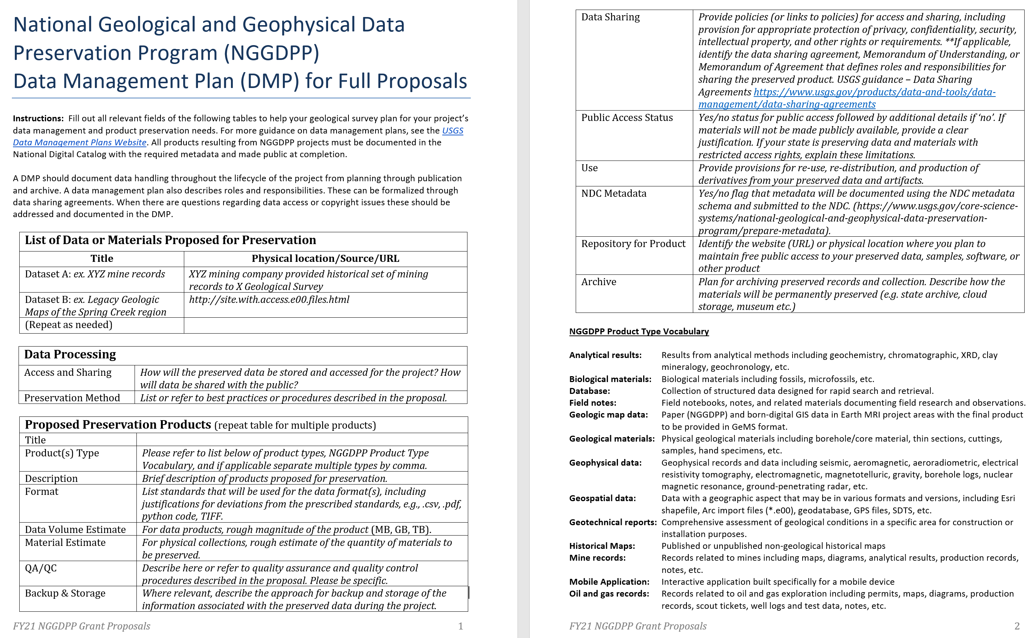
Data Management Plan (DMP)
Data Preservation: Grant Templates => Data Management Plan

Slide 31
Budgets
Budget sheet 1: Data preservation project (P1) and Data Preservation Workshop
Budget sheet 2: Critical Minerals (P2), long term preservation strategy ($3K), and Critical Minerals Workshop – all part of $35K total from USGS
In each budget sheet: state cost can exceed federal cost (but, not the other way around).
100% State to federal match applies in each budget sheet. Individual budget line items do not have to be matched but category totals must be.
Both workshop travel budgets must have 100% match
P2 long-term preservation strategy must have 100% match
Each Priority total must be 100% match (or greater)

Slide 32
Proposal Review Panel
Seven panel members possessing expertise in physical sciences, data management and/or preservation
3 state geological survey representatives
3 USGS representatives
1 federal or academic, non-USGS representative
Panelists maintain confidentiality and declare all conflicts of interest

Slide 33
Proposal Evaluation Criteria
Technical merit of proposed work and probability of successful outcome.
Societal benefits from increased access to materials and data resulting from preservation project.
Knowledge, performance, experience of project team.
Appropriateness and reasonableness of budget.
* The 4 criteria are equally weighted

Slide 34
Successful Proposals…
Clearly identify the issue(s) to be addressed. Is it possible to address in a single year? Is it envisioned as part of a multi-year effort?
Provide clear justifications for the proposed work – Why is it important? Who will use the results? How does it meet your survey’s goals?
Summarize previous NGGDPP funded tasks when related to current proposal, especially if it informs workflows, methods and/or level of effort.
Incorporate feedback provided by previous panel reviews as relevant.
Data Preservation: Proposal Tips and Examples

Slide 35
Successful Proposals…
Clearly describe the relevant qualifications and expertise of the primary participants.
Describe methodologies and workflows with appropriate personnel expertise, time estimates, and QA/QC procedures.
Demonstrate understanding of the effort to complete the task(s) through previous work/pilot projects or a representative example.
Follow recommended practices and reference them.
Describe how the project improves access to data and/or preserved materials.
Tie to long term preservation strategy.
Data Preservation: Proposal Tips and Examples

Slide 36
Successful Proposals…
Provide a clear data management plan including where the data/resources will be archived and how they are accessed.
Verify that the federal share is 100% or less in each budget sheet.
Example successful proposals:
Traditional preservation activities – KGS, UGS
Technology focused activities – preservation of video/recordings (IGS)
Data Preservation: Proposal Tips and Examples

Slide 37
Project deliverables
Collection level metadata entered/updated in NDC
Item-level metadata entered/updated in NDC, conforming to NGGDPP metadata schema
Borehole information compiled in template and uploaded to NDC
Critical mineral information (deposits and districts) recorded in templates and uploaded to NDC
Digital map products (GeMS) submitted to NGMDB (ngmdb@usgs.gov)
Final Technical Report (FTR) (< 5 pages)
Data Preservation: Grant Templates => Optional FTR template

Slide 38
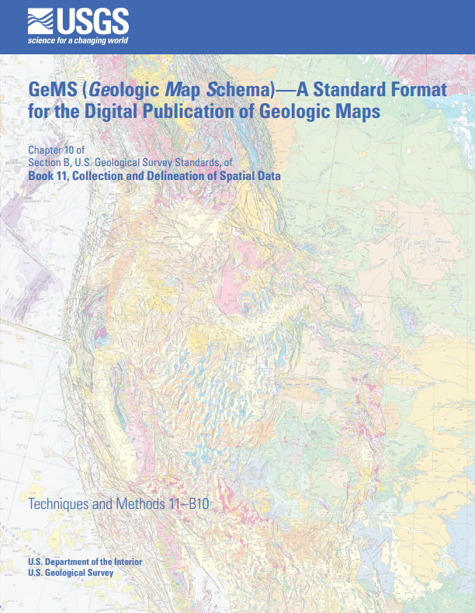
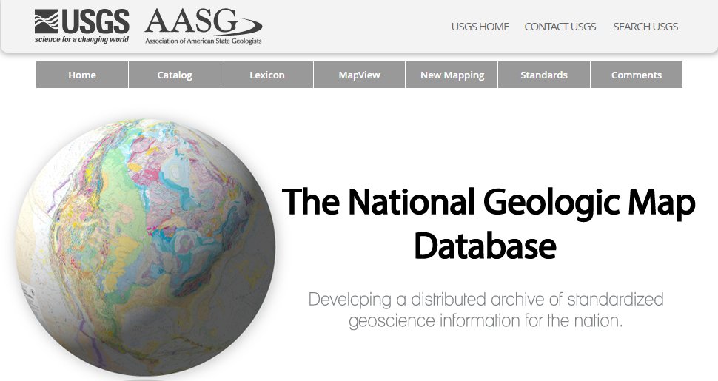
GeMS – Geologic Map Schema
https://ngmdb.usgs.gov/Info/standards/GeMS/

Slide 39
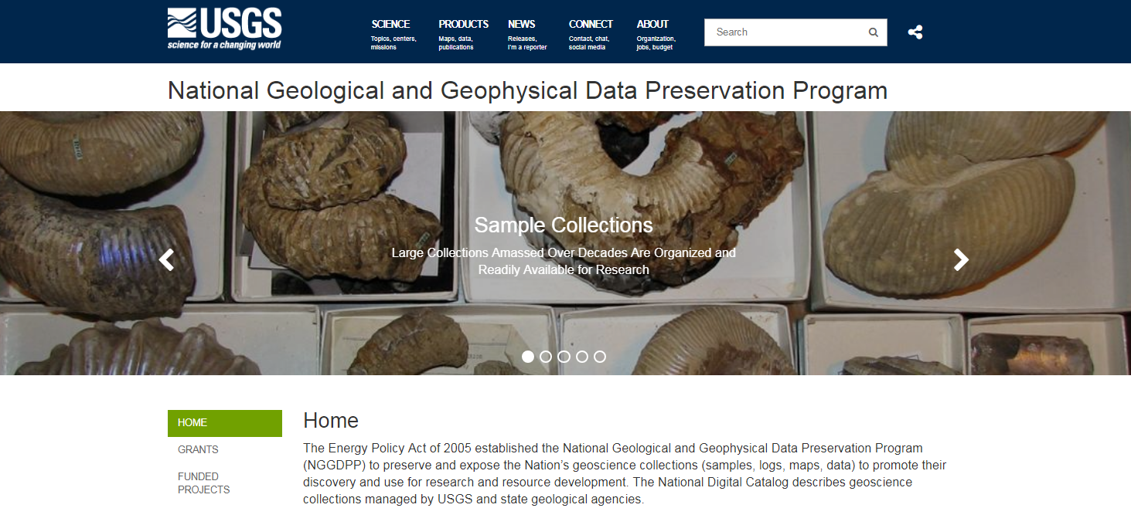
Data Preservation site
https://www.usgs.gov/datapreservation

Slide 40
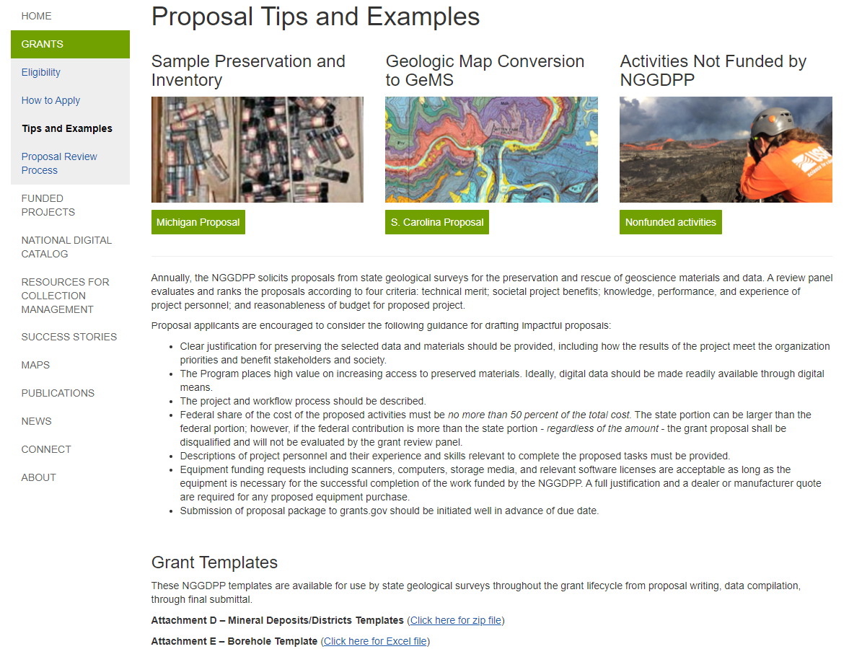
Data Preservation site: Grant Templates
https://www.usgs.gov/datapreservation

Slide 41
NDC Dashboard
https://www.sciencebase.gov/ndcDashboard/

Slide 42
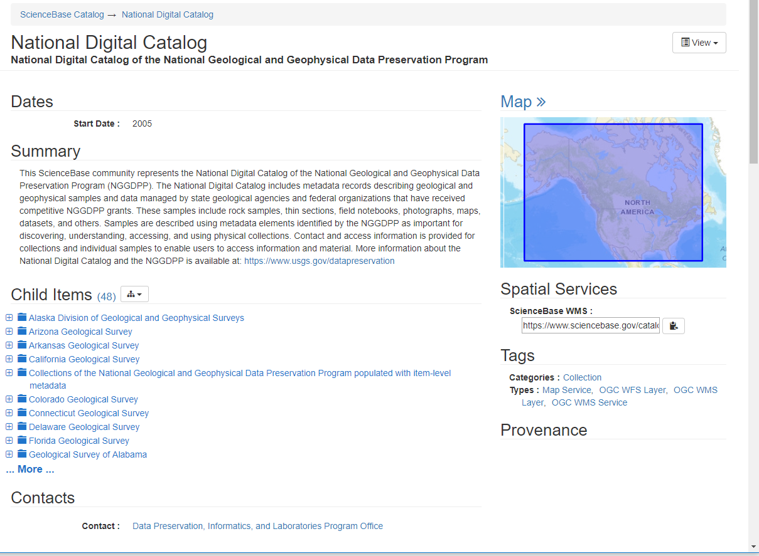
National Digital Catalog – Current State
Central Catalog for All NGGDPP activities
Started in 2007, ~3.7 million items
Collections organized by State
Broad range of content
Physical Items – Core, cuttings, outcrops
Data items – Maps, images, well logs, analyses
Stores Metadata
Points to digital or physical location
Minimal elements & limited quality checks
FAIR: Difficult to find, access, use, and maintain
*FAIR = findable, accessible, interoperable. and
reusable
Michaela Johnson – mrjohns@usgs.gov

Slide 43
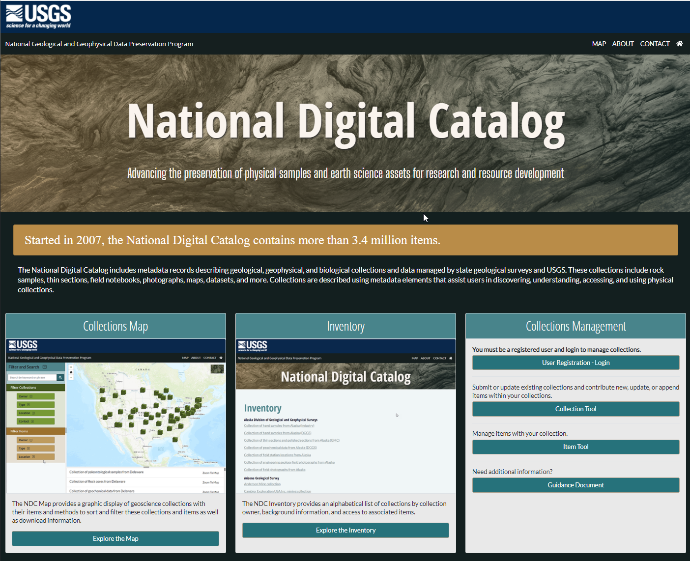
Improvements to the NDC
In active development status
Metadata collection profile – mdTools editor
New NDC API
Mapping and search interface
New consolidated dashboard
Metadata
Expand and standardize required elements
Implement controlled vocabularies
New item-level ingest
Map and Search
Elastic search
Build map-based search capability
Improve the user interface and experience
Maintenance
Support harvesting from other data sources (where available)
OTWSC – Integrated Hydrology and Data Science Branch re-architecture began FY21

Slide 44
Improvements in progress
National Index of Borehole Information (NIBI)
Overview Wednesday, 10/27 @ 12PM MT
Pilot FY 2022
Q1 – Pilot participant invitations (~10 state, ~3-5 fed)
Full implementation FY 2023
Collection-level metadata profiles
Draft collection profile in mdJSON
mdEditor to create/update
Need: embedded controlled vocab
Re-architecture of National Digital Catalog
Overview Wednesday, 10/27 @ 12PM MT

Slide 45
Contacts
General inquiries: nggdpp@usgs.gov
Lindsay Powers, Program Coordinator
720-292-8595, lpowers@usgs.gov
Mikki Johnson, Associate Program Coordinator
720-250-8763, mrjohns@usgs.gov
Contracting topics
Maggie Eastman, USGS Contracting Officer
(703) 648-7366, mrussell@usgs.gov

